Slide 1
Logarithmic Transformations

Slide 2
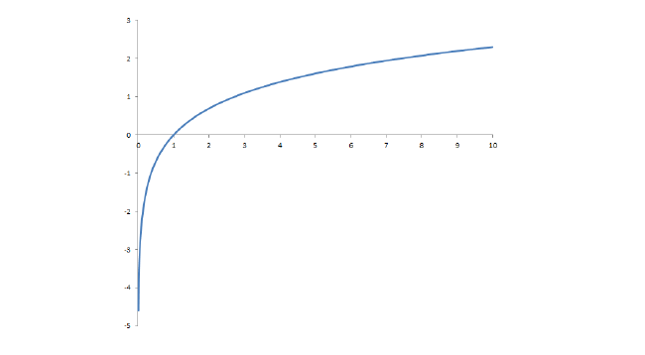
Logarithmic Transformations
The (natural) logarithm is a mathematical function which has the following shape. Note that you can only take the logarithm of a positive number.

Slide 3
Logarithmic Transformations
One of the chief reasons that we want to take the log of a variable is if that variable is positively skewed or if there are large outliers.
Taking the log of that variable will make the distribution of the variable more symmetric.
This will make the central limit theorem “work faster.”
It can also make relationships easier to identify.

Slide 4
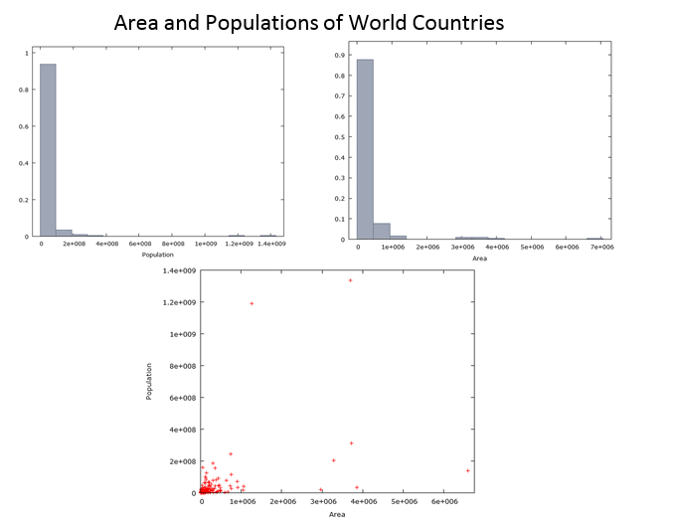

Slide 5
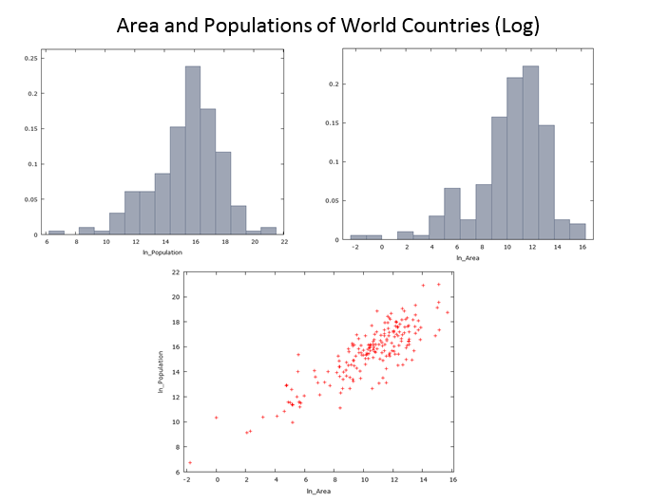

Slide 6
When to use Logarithms?
Most strictly positive variables are also positively skewed.
Examples: salaries, incomes, counts, sizes, etc.
Check the frequency distribution of these types of variables.
If there is a strong positive skewness or if there are a few large outliers, it may be a good time to use the log of the variable instead of the variable itself.

Slide 7
Interpreting Log Regressions
Variables that are transformed with a log are interpreted in percent terms.
This is another reason to use log transformations.
When you take a log and interpret something in percent terms, the units don’t matter.
If I say that I weigh 10% more today compared with a year ago, this doesn’t matter if my weight is measured in pounds, kilograms, ounces, etc.

Slide 8
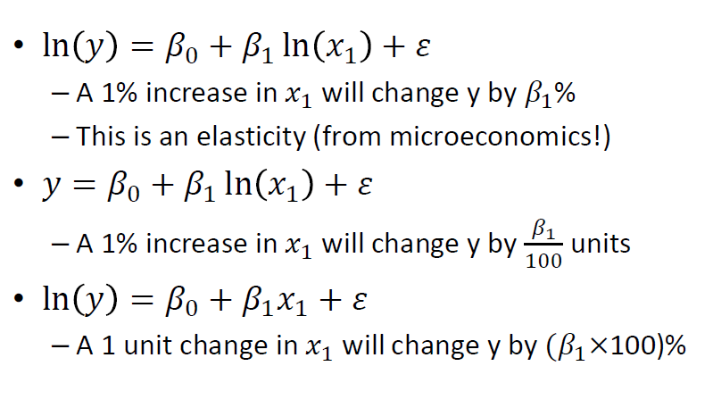
Interpreting Log Regressions

Slide 9
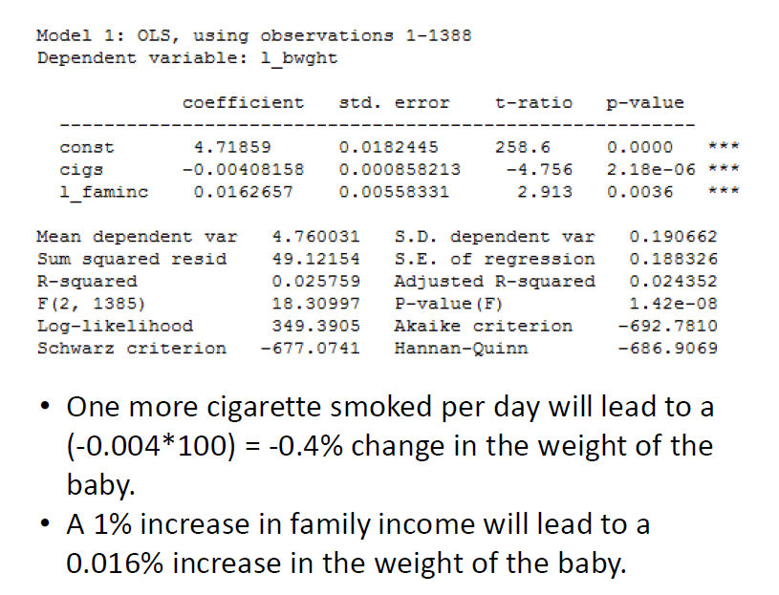

Slide 10
